Slide 1
Learning Unit 3 Broodstock Management and Seed Production
Faculty of Resource Science and Technology

Slide 2
Under this learning unit, you will learn the:
Broodstock management
Seed production
Larval rearing

Slide 3
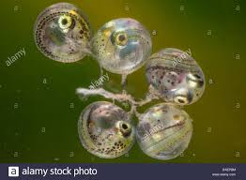
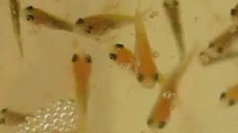
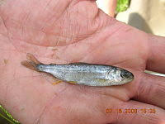
Seed Production
What is this???
‘Seed Production’ in aquaculture
Seed production in aquaculture comes with three important stages of fish, which are:
1. Larvae: hatchlings with yolk sack until first feeding.
2. Fry: it is free swimming fish - from first feeding until complete development of somatic organs
3. Juveniles: as “fingerlings”, or a small size fish, not sexually mature

Slide 4
Seed Production
Two methods, which are:
Method 1: Collection of seed from the wild source
This is the first method which occurs for those fish species, which:
spawning behavior is not controlled
spawning behavior is not well understood
he costs of artificial propagation are too high
where fry in large quantities is easily obtainable
e.g. West African cat fish (Chrysichthys walkeri), Milk fish (Chanos chanos), Mullet species (Mugil cephalus) etc.

Slide 5
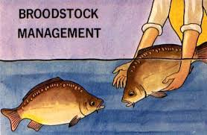
Method 2: Production in fish hatcheries
There are many different forms of controlled reproduction, but all achieve the result of fertilized eggs
Can be achieved using suitable propagation methods for each aquaculture species
Propagation can only be succeed if broodstock are well cared of

Slide 6
1. Broodstock management
What is broodstock fish???
Broodstock, or broodfish, are a group of mature individuals used in aquaculture for breeding purposes.
Based on FAO, the brood-stock management covers three particular aspects of the rearing process, which are:-
(a) The selection of fish with desirable hereditary qualities i.e. good brood fish good seed
(b) The selection of fish with well-developed sexual organs.
(c) The rearing of these selected fish

Slide 7
Broodstock management
Broodstock of different species require different condition for a successful breeding
Females and males are better kept in separate broodstock ponds to prevent natural spawning
Two sets of ponds for the spent spawners are also needed
Important to focus on the nutrition for broodstock especially female to develop eggs
Optimum 30-40% protein level and low fat feed to prevent fat in gonads

Slide 8
Distinguish characteristics between male and female broodstock
Factors | Male Brood | Female brood
Color | More brighter or bolder | Less brighter
Size | Smaller than female | Comparatively bigger than male
Size of fin | Larger than female | Smaller than male
Shape | Not well-rounded | Well-rounded
Abdomen | Harder than female | Softer than male
Mouth | Having thicker lips with a more pronounced appearance | Comparatively thinner lips
Genital pore | Not open | Open, swollen, protruding, and reddish
Tubercles | Have on the operculum | Absence on the operculum
e.g. Siakap
**Distinguishing characteristics vary depending on species

Slide 9
Brood-stock selection for breeding
Healthy
Injury-free
Parasites-free
Scale normally distributed
Normal body formation, proportion and weight
Body should possess the require shaped and proportions, being neither fat

Slide 10
Factors affecting on spawning of brood-stock in tropical regions
Seasons of the year. Rainy season is preferred
Photoperiod
Photoperiod
Temperature
Rainfall
Water volume
Water velocity

Slide 11
2. Seed production in Aquaculture
The shortage of fish seed collection in the wild source resulting to establish fish hatchery in aquaculture who produce the fish seed by adopting induced breeding.
Methods adopted in fish hatchery for fish seed production
Natural spawning - takes place in a pond/tank with little or no outside intervention.
Induced spawning without hormonal treatment - by simulating natural spawning conditions in the ponds or tanks.
Natural spawning with hormones - final maturation of reproductive products is brought about by injection of hormones, after which the fish spawn naturally in ponds or tanks.
Artificial spawning with or without hormonal treatment - one obtains sexually matured broodstock, either through hormonal treatment or not, one extracts the eggs and sperm manually, fertilization is done manually, and the eggs are incubated.

Slide 12
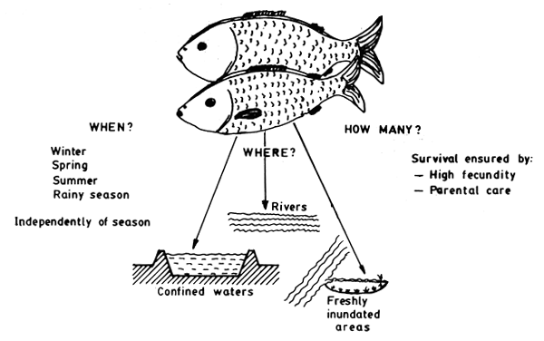
Methods adopted in fish hatchery for fish seed production (Source: FAO website)
Fig. Adaptation for the survival of the species - Reproduction

Slide 13
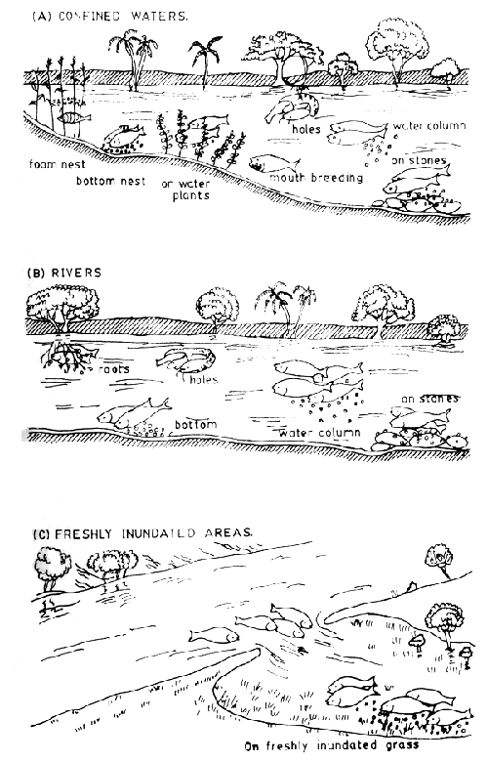
Methods adopted in fish hatchery for fish seed production (Source: FAO website)
Fig. Spawning places of freshwater fishes

Slide 14
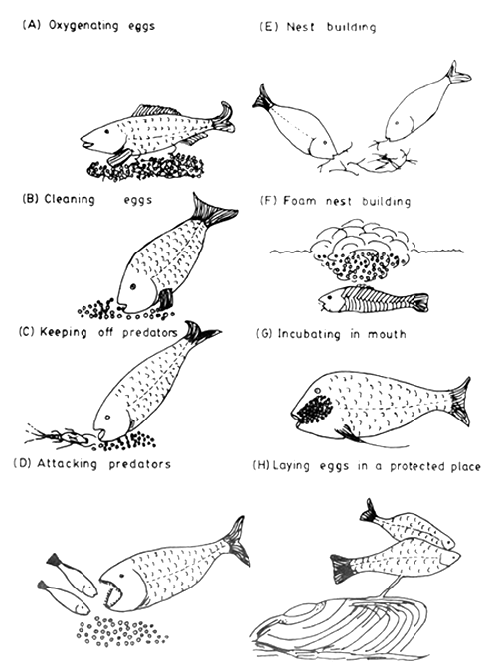
Methods adopted in fish hatchery for fish seed production (Source: FAO website)
Fig. Principal types of parental care in fishes

Slide 15
Substances used for seed production from fish in present aquaculture
1. Pituitary gland or PG
2. Human chorionic gonadotrophin or HCG
3. Mammalian gonadotrophic hormones or Leutinizing Hormone Releasing Hormone or LHRH

Slide 16
In fish, the reproductive process involves three basic steps:
Maturation - the development of the gametes (eggs and sperm) to a point where fertilization can occur;
Ovulation - the release of eggs from the ovary; and
Spawning - the deposition of eggs and sperm so that they can unite.

Slide 17
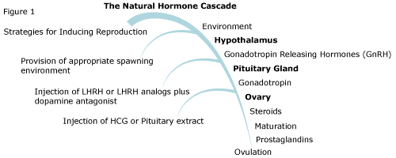
Hormones as chemical messengers mix with the blood by pituitary gland.
The hormones travel through the bloodstream to other tissues, which respond in a variety of ways.
The hormonal cascade occurs resulting the ovulation

Slide 18
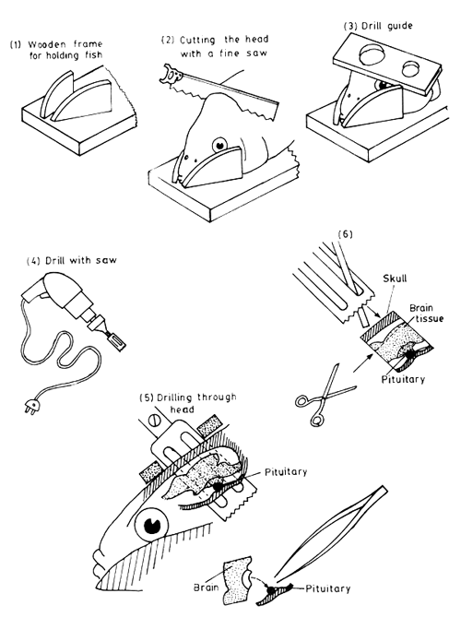
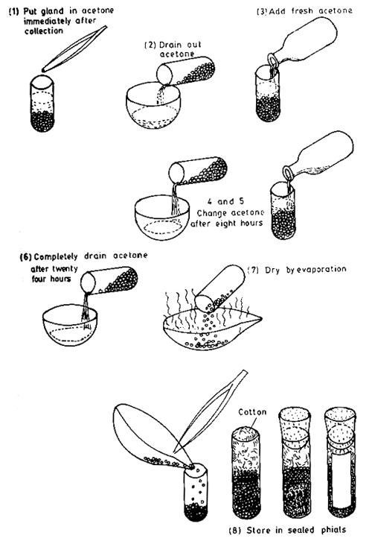
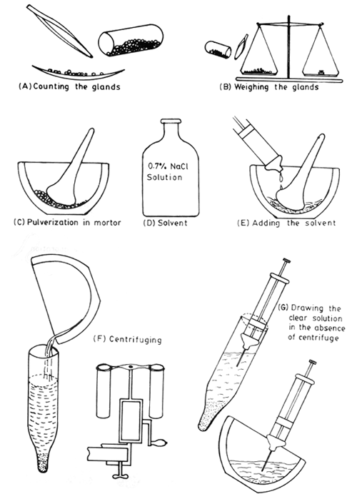
Extraction and procession method of Pituitary Gland from the fish head
a. Extraction of pituitary gland from fish
b. Preparation of acetone-dried pituitary gland
c. Preparation of pituitary gland to be used for induced breeding

Slide 19
Why Pituitary Gland?????
BECAUSE….
It is much cheaper;
It is more stable and thus has a longer shelf life;
It comes in a purified form.

Slide 20
Dose of Pituitary Gland
Two doses:
1st dose PG-0.5 mg/kg+ 0.5 ml distilled water after 6 hours 2nd dose PG-7-8 mg/kg+ 0.5 ml distilled water

Slide 21
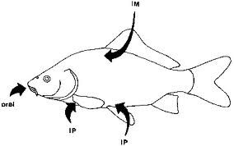
Injection of Hormones
i) Intraperitoneal injection (IP)
injection of a substance into the
peritoneum (body cavity).
ii) Intramuscular injection (IM)
- dorsal muscles above the lateral line
- below the anterior part of the dorsal fin
- dorsal part of the caudal peduncle
Intramuscular injection (IM)
Intraperitoneal injection or IP

Slide 22
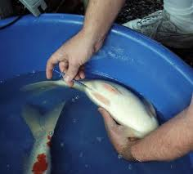
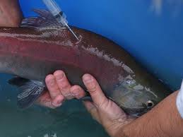
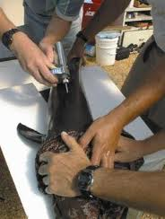
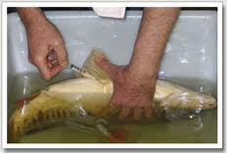
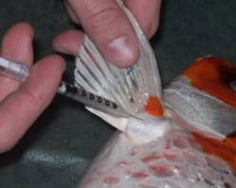
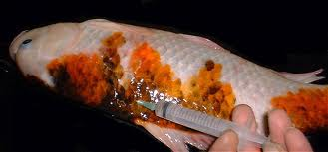
Injection of Hormones
i) Intraperitoneal injection (IP)
ii) Intramuscular injection (IM)

Slide 23
Maturation process
The process of final maturation;
migration of the nucleus to the animal pole
fusion of the yolk
breakdown of the germinal vesicle followed by first meiotic division
ovulation (rupture of the follicles and accumulation of the ripe eggs in the ovary cavity)
Once these processes start the eggs must either be spawned or stripped

Slide 24
Stripping
It is a pressing method of releasing eggs and sperms from the fish abdomen;
Should be carried out as soon after ovulation as possible, so the fish should be checked after 6-12 hours final injecting;
Before stripping, both the male and female should be cleaned and dried around the vent with a soft towel because residual anesthetic will kill sperm.
Water, fish “slime”, feces, and blood should not be allowed to mix with the gametes as they are stripped.
e.g. All types of carp fishes are needed to strip for reproduction.

Slide 25
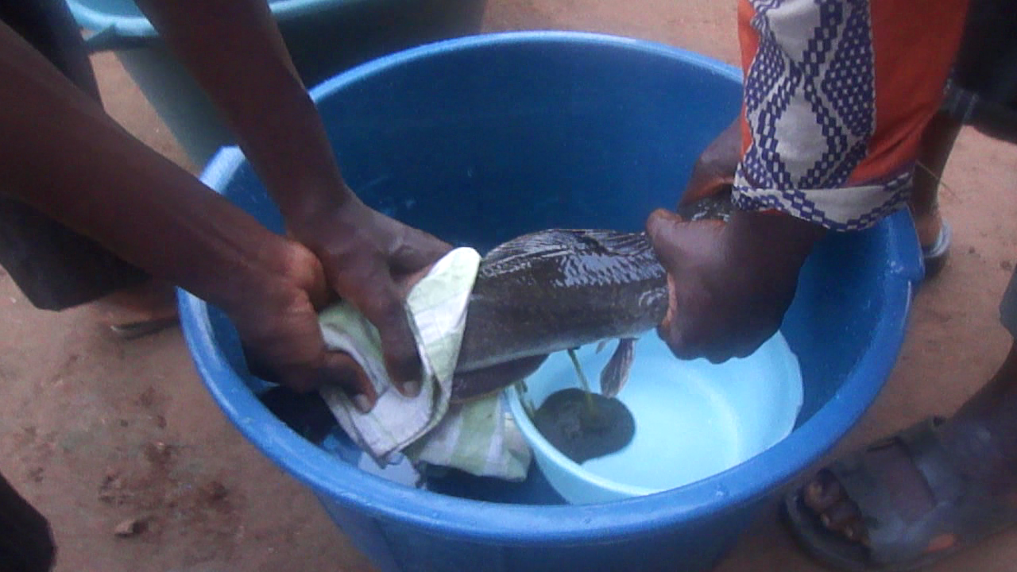
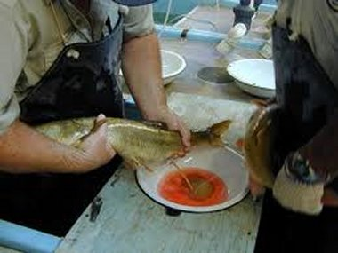
Stripping method
Stripping off the eggs from female

Slide 26
Fertilization
Quantity of water added to sexual products during fertilization is important to determine success.
If too much water is added
- sperms will not be able to reach the micropyle
If too little water is added
- micropyle of an egg get blocked by other eggs
Eggs must be stirred continuously until they are placed in the hatching tanks as the eggs become sticky and without stirring will stick together into one clump.

Slide 27
Incubation
Some incubation techniques;
The eggs are spread out on the bottom of a concrete basin.
The eggs are spread out on a screen (mesh size 1 mm) which is placed on the bottom of a concrete basin.
The eggs are allowed to “stick” to the roots of floating water hyacinth (Eichhornia crassipes) placed within a happa made from mosquito netting (mesh size 0.5 mm) located within a concrete basin with running water or in a pond.
The eggs are allowed to “stick” to the roots of floating Nile cabbage/water lettuce (Pistia stratiotes) placed within a happa located in a concrete basin.
The eggs are allowed to “stick” to a brush which floats inside a concrete basin or happa.
It is also possible to incubate eggs and hatchlings in stagnant water, using oil drums/barrels, or inside a happa placed in a pond.

Slide 28
Seed production techniques of some important fishes:
Fish group | Seed production technique
Common carp (Natural method with or without injection) | Temperature 18-22°C (max 25°C); Ponds should be small, 100-1000m², shallow and one places “kakabans” or bunches of grasses to collect the eggs at 20 to 30 cm from the surface; Submerged aquatic plants covered the pond bottom, clean water, rich in dissolved oxygen and little turbidity, and stable meterologic conditions; Broodstocks (male and female) received an injection of pituitary extract for quick response at a dose of 2 to 3.5 mg/kg using an intramuscular injection and released in the waterbody Within 12-24 hours, the eggs are seen on the kakabans, they can be picked up and transferred to a hatching pond or first stage larval pond
Common carp (Artificial breeding) | Room Temperature min19°C, max 30°C Pituitary extract are used in two times (6 hours interval) for female (first 0.3 to 0.5 mg/kg and second 3.5 to 6 mg/kg) , one time for male (0.5 to 2.5 mg/kg) at the same time as the second dose for the females. Stripping event occurred after 9-13 hours depending on the surrounding temperature. 200 mg female eggs mixed with 1 mg male sperm and 5 ml distilled water mixed gently using chicken feather and placed in incubator jar for hatching for 24 hours Hatching eggs are transferred into larval tank

Slide 29
Fish group | Seed production technique
Cat fish (Natural spawning without injection) | It occurs in natural water body which area is of 8 – 15 m²; Covering the bottom with river gravel; A peripheral canal in the shape of a U is dug around the edge of waterbody; 2 males and 1 females brood are stocked in the morning Water level is slowly increased until nightfall and natural spawning occurs in the night; if not water level downed in the next day and slowly increased for successful breeding. Remove parents carefully after observing the fertilized egg and keep these until 25 days
Cat carp (Induced breeding) | Induced spawning is done pituitary extract from Clarias at 4 mg/kg 1 female brood catfish is stocked in the morning and injected pg extract Males are chosen by their agressiveness; after an hour of combat, the winner is chosen. At nightfall, 8 to 10 hours after the injection, the couple is placed in a tank of about 1.5 m² of surface area, where the bottom is covered with gravel, water is running Remove parents carefully after observing the fertilized egg and keep these until 25 days
Cat carp (Artificial breeding) | Similar to Induced spawning i.e. 1 female injected with pg extracts at 4 mg/kg dose After 8-12 hours, the eggs are usually matured and stripping for releasing eggs Sperm is obtained by pulverising the testes of the male fish as their particular anatomy makes it impossible to obtain milt by normal abdominal pressure, mix with eggs using feather and the fertilized eggs transferred to incubator for larvae.

Slide 30
3. Larval rearing in Aquaculture
This is first stage in aquaculture
After incubation of fertilized egg, the larvae stage is started and then post larvae stage
These are reared in glass aquarium with egg yolk first three days, then live feed artemia or rotifer
The live feed density increases with rearing days. For example:
Rotifer Artemia
3-8 days 2 nos./ ml 3-5 days 1 no/ml
9-21 days 5 nos./ml 6-15 days 3 nos/ml
15-21 days 5 nos/ml
After 20-21days, the larvae metamorphose turns into fish fry and transferred to nursery tanks or ponds for further rearing

Slide 31
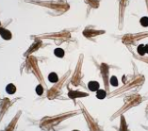
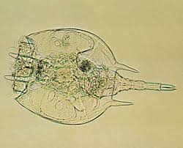
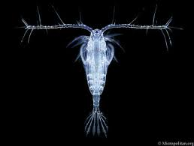
Live feeds and its culture technique
After three days of incubation of fertilized fish eggs, the larvae metamorphose needs live feed which are usually three types presently used in aquaculture:
1. Artemia: a brine shrimp grows in high concentration of saline water
2. Rotifer: Near-microscopic pseudocoelomate animals, found in fresh water.
3. Copepod: Small crustaceans found in the sea and brackish water.

Slide 32
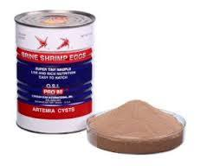
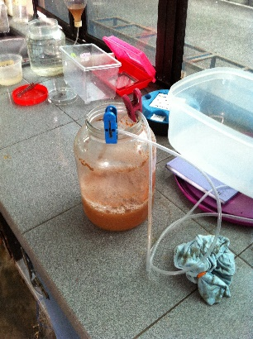
Artemia
Artemia eggs are usually available in commercial market as powder form
Take a clean container with 1 litre normal water
Mix 30 gm sodium chloride gently; ensure the continuous aeration
Mix 1 gm artemia eggs powder gently and ensure the continuous aeration up to 24-36 hours at room temperature
After 24 hours of incubation, the water color turns into red meaning the artemia is hatched and separate the artemia using genral filtration method
REMEMBER: Artemia lose their nutritional value after 10 - 12 hours of hatching. So use before that……

Slide 33
Rotifer
Rotifers can be produced using algae, yeast, or other custom products, or a combination.
Rotifer production range from 100 to 10,000 animals per ml.
Rotifers are usually maintained in larvae tanks at a density of 5 to 30 per ml of larval tank water.
Copepod
It is most time consuming culture.
For copepod production, please read http://www.fao.org/docrep/003/W3732E/w3732e0t.htm

